Slide 1
Printmaking

Slide 2
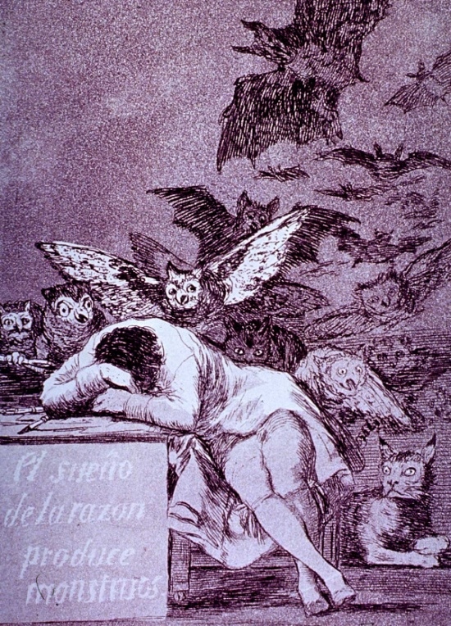
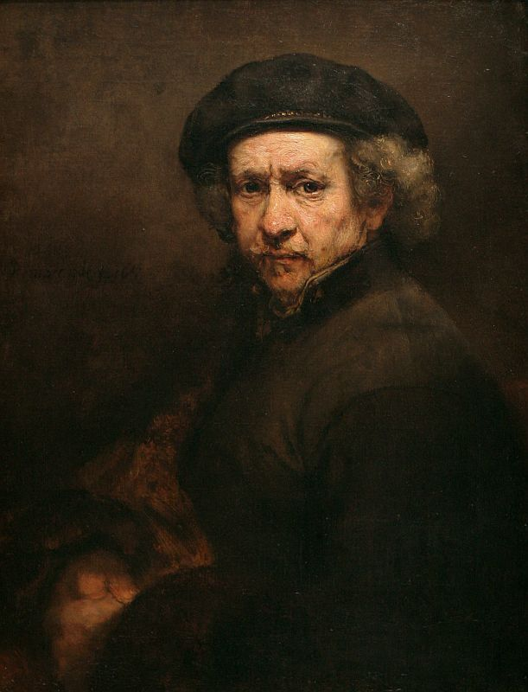
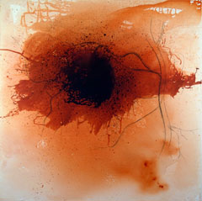
Emphasis/ Center of Interest
Emphasis is an area in an artwork that visually stands out from the rest of the piece
Artists use center of interest to attract and hold a viewer’s attention
The viewer often starts at a piece’s center of interest, moves around, and then ends back at the center of interest.
We can create emphasis by the use of contrast and variety

Slide 3
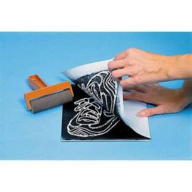
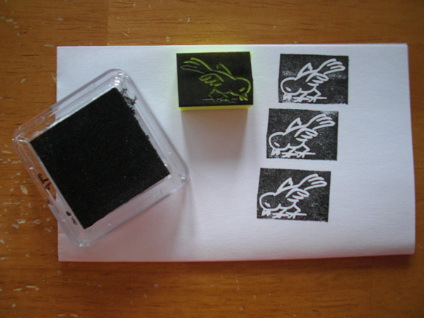
Foam Plate Printmaking

Slide 4
Printmaking is…
A type of art that uses an inked block or plate to print an image.
This allows multiple printings, unlike drawing or painting.

Slide 5
Printmaking started in China
The Chinese developed a printing technique called “woodcut” to print books of Chinese characters and images, around 100 AD.

Slide 6
Some Famous Printmakers are…
Andy Warhol, 1960s
Albrecht Dürer, 1500s

Slide 7
Some More Famous Printmakers…
Chuck Close, 1986
Katsushika Hokusai, 1800s

Slide 8
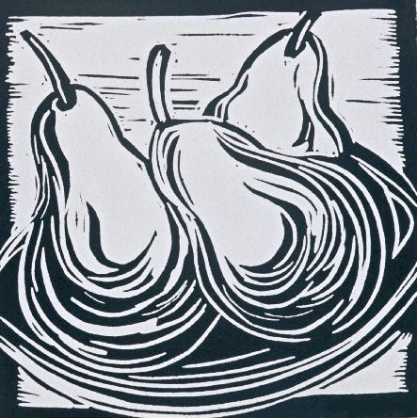
Your project is to carve a linoleum block

Slide 9
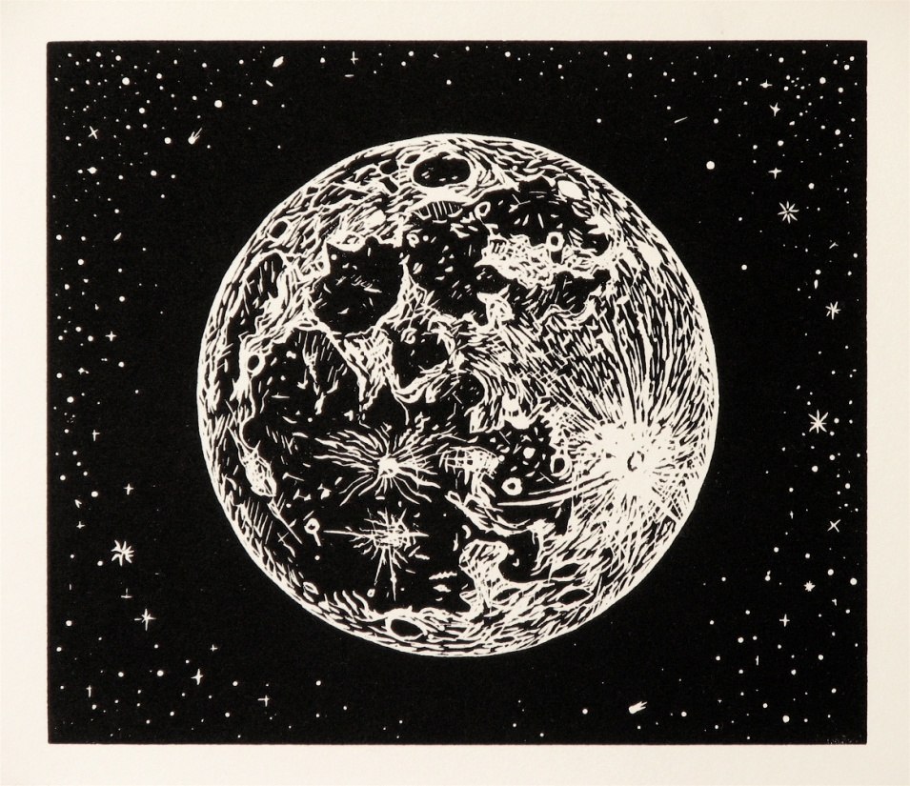
Things to Know…
New Vocabulary
Block: the foam/wooden/linoleum piece you carve
Gouges: sharp tools used to carve out linoleum strips
Print: an inked impression of your block, placed on paper (this is what you’ll turn in)
Edition: lots of prints that all look exactly the same

Slide 10
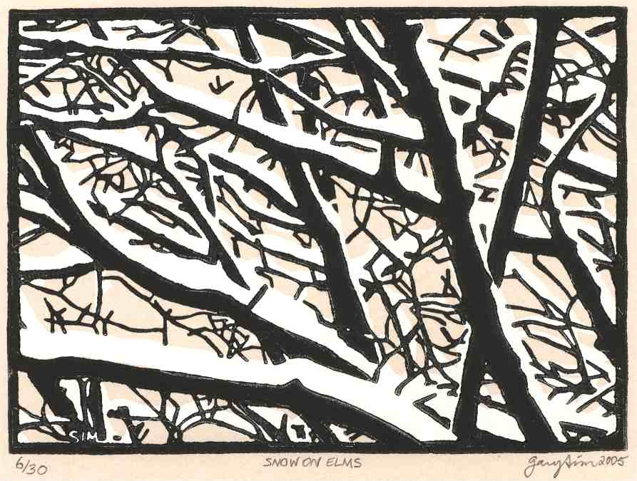
What does a linoleum cut look like?
Lino cuts have simple lines
They are carved with sharp tools called ‘gouges’
They print backwards – this is due to the printing process

Slide 11
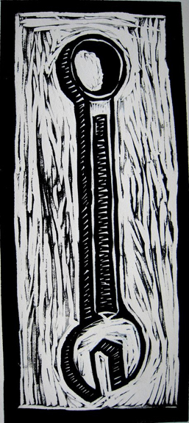
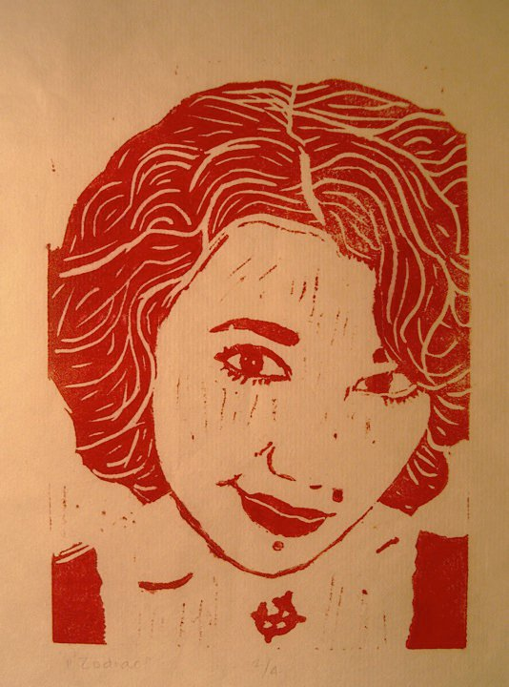
More linoleum cut examples…
These marks are called “chatter” and are left over from the carving process
Some artists choose to leave more chatter than others

Slide 12
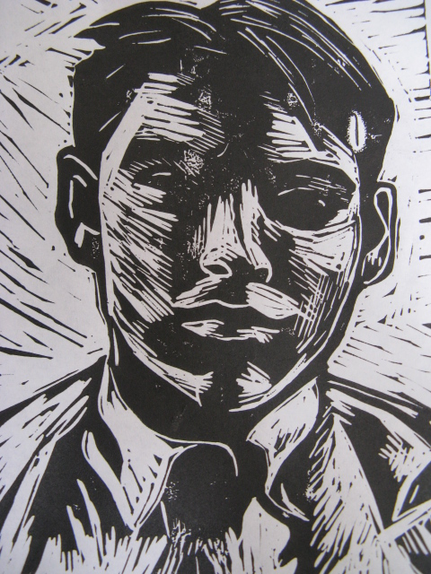
Choosing Ideas
Linoleum Cuts use Line
Things to Consider
Your image will print backwards (mirror-imaged)
There is no shading in linoleum cuts; only black or white (respectively)
Your print is created by carving out lines
It’s very difficult to put detail into a lino cut

Slide 13
Your Assignment (Foam Plate)
Use images and create 2-3 sketches showing what you will carve away (negative space) and what you will leave behind (positive space)
Check off your print idea with Mr. Jensen
Use a foam plate “block” to carve away the negative shapes and leave the positive shapes.
Total of four prints (four/two to a page)
Prints need to be clean, clear, well defined, and evenly inked

Slide 14
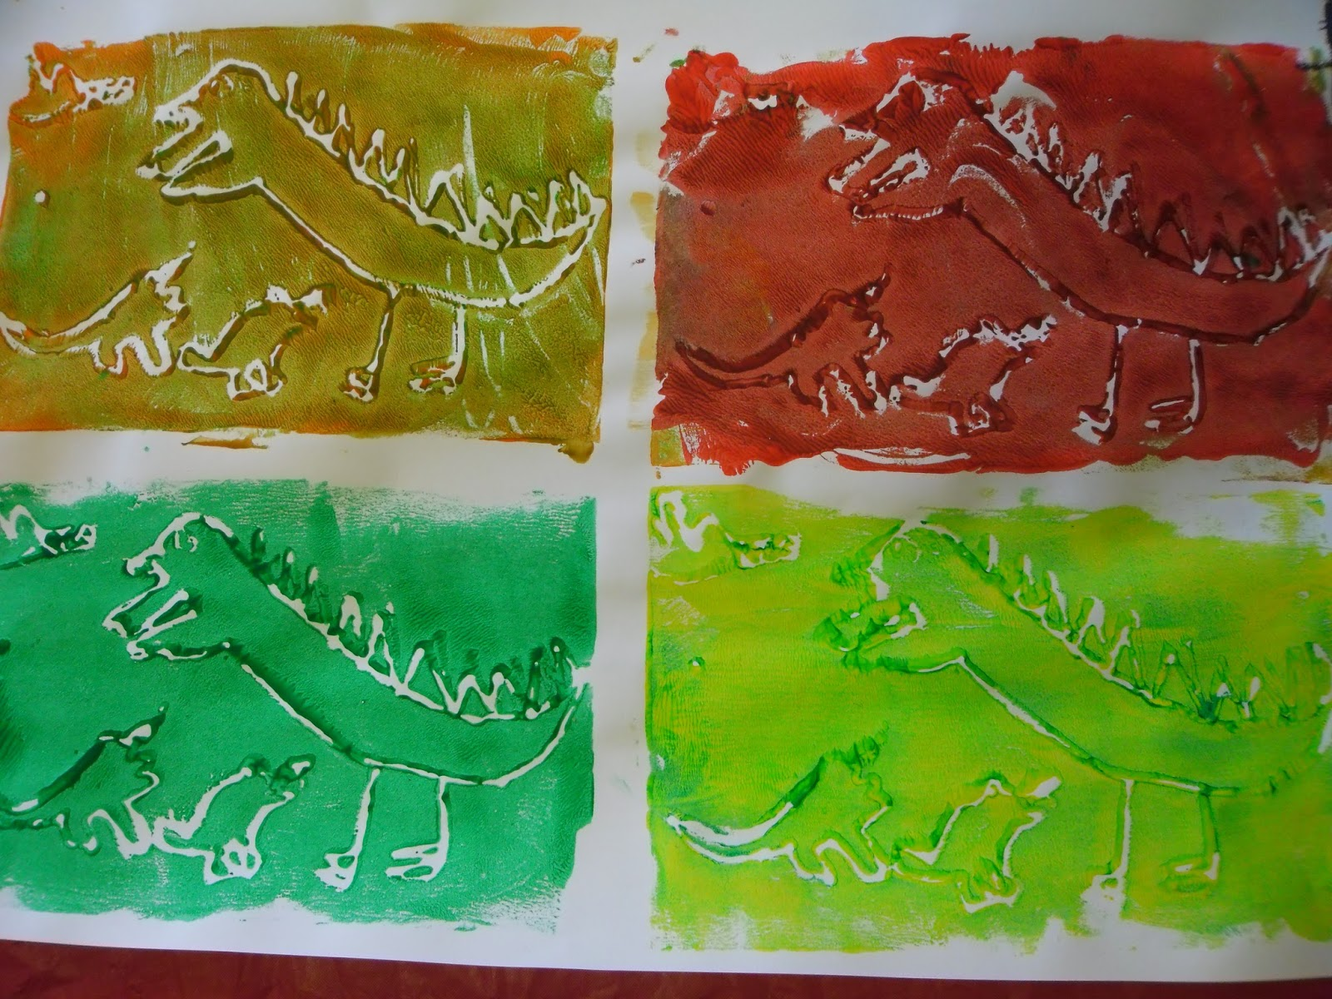
What not to do

Slide 15
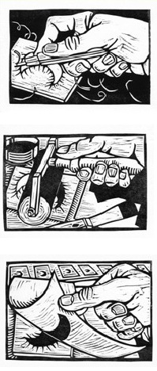
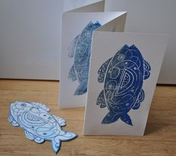
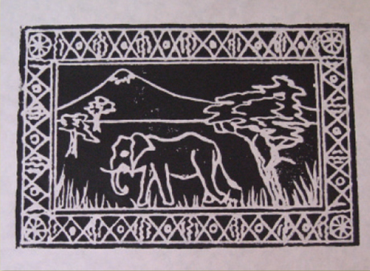
What to look for in your “block”

Slide 16
Your Assignment (Linoleum)
Use images and create 2-3 sketches showing what you will carve away (negative space) and what you will leave behind (positive space)
Check off your print idea with Mr. Jensen
Set up carving block and check tools out with Mr. Jensen
Use a linoleum “block” to carve away the negative shapes and leave the positive shapes.
Total of four prints.
One print per page/centered/ labeled.
Prints need to be clean (no smudges or marks with clean edges), clear( lines and shapes are defined), well defined (ink does not fill in lines), and evenly inked.

Slide 17
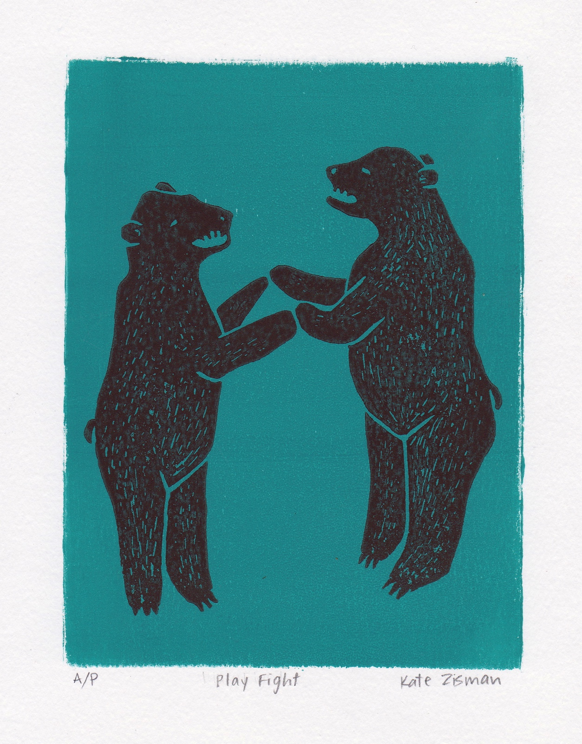
LABEL YOUR PRINT
PRINT NUMBER:
1/4, 2/4, 3/4, & 4/4
TITLE
NAME

