Slide 1
One Point Linear Perspective

Slide 2
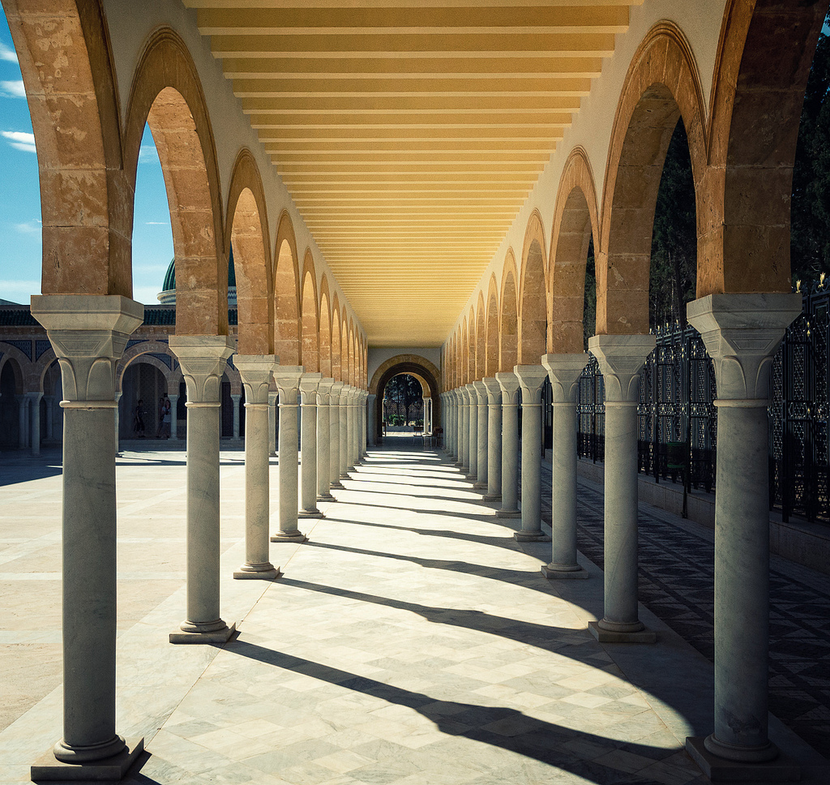
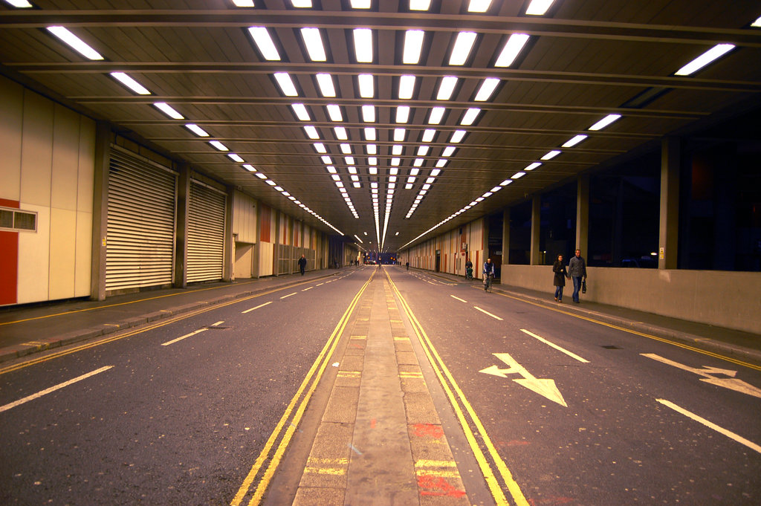
Seeing in perspective

Slide 3
Brunelleschi’s Vision

Slide 4
Leonardo Di Vinci’s The Last Supper

Slide 5
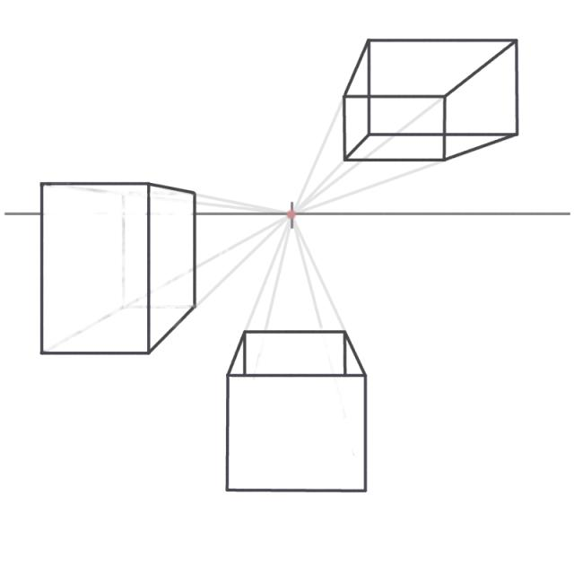

Slide 6
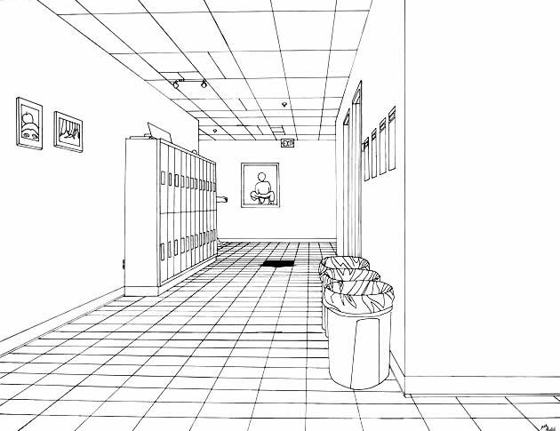
Drawing a hallway

Slide 7
Drawing a room

Slide 8
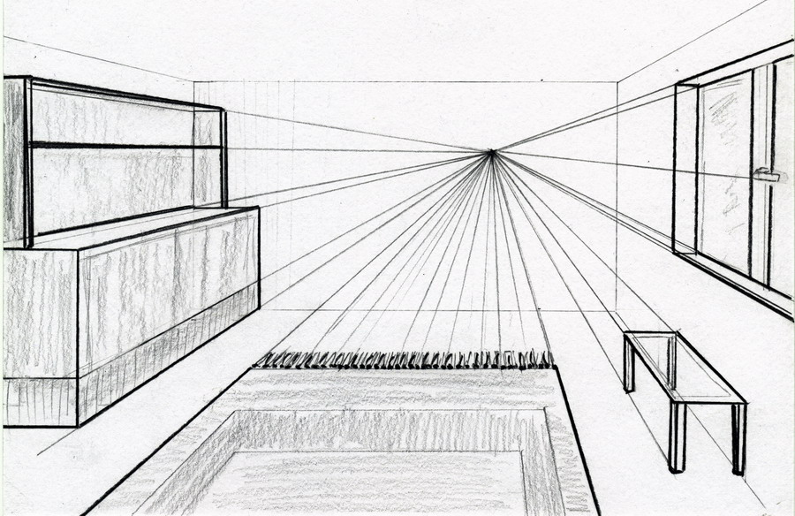
Drawing a room

Slide 9
Piero Della Francesca’s Ideal City

Slide 10
Raphael's School of Scholars

Slide 11
Drawing Letters

Slide 12
Victor Vasarely

Slide 13
One point introduction

Slide 14
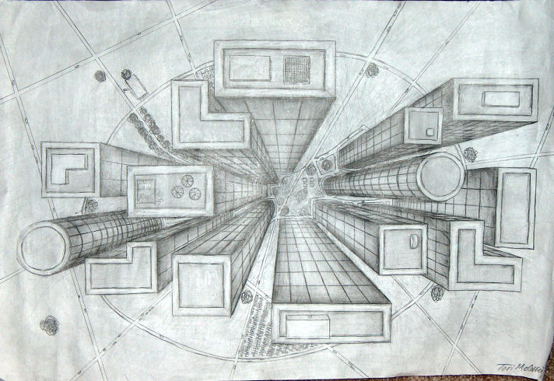
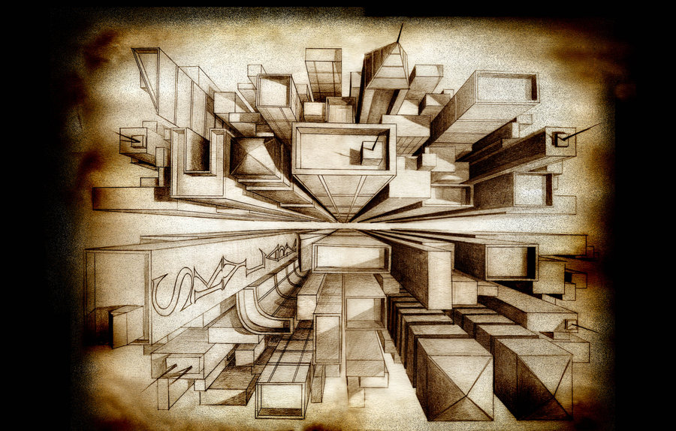
Bird’s Eye

Slide 15
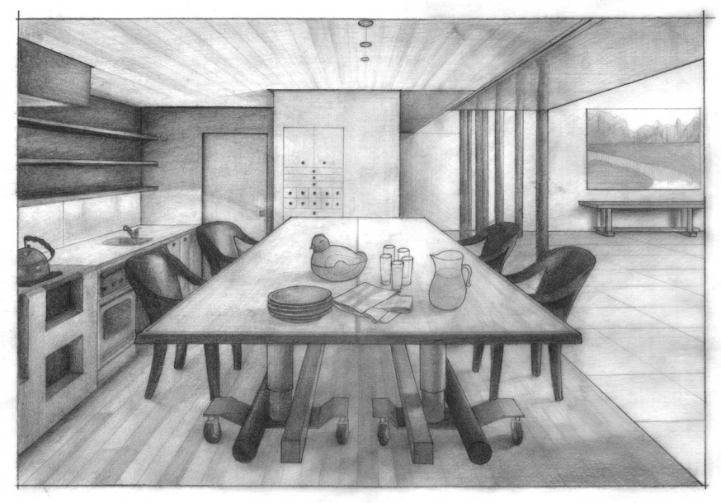
One Point Room

Slide 16
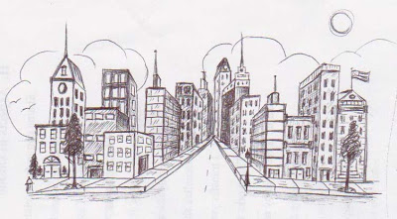
One Point City

