Slide 1
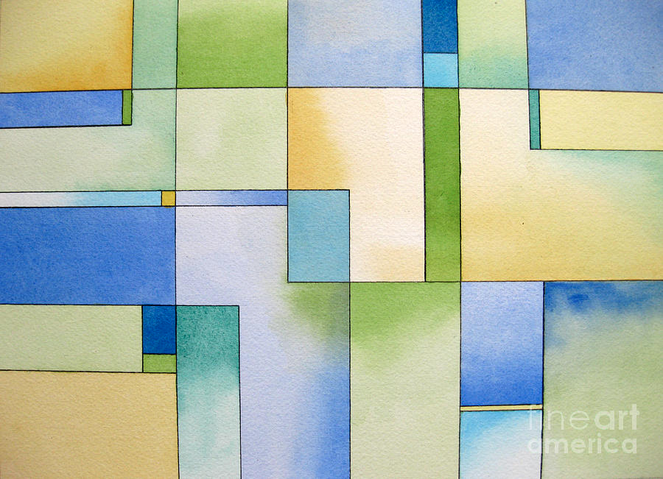
Illustrated Phrases

Slide 2
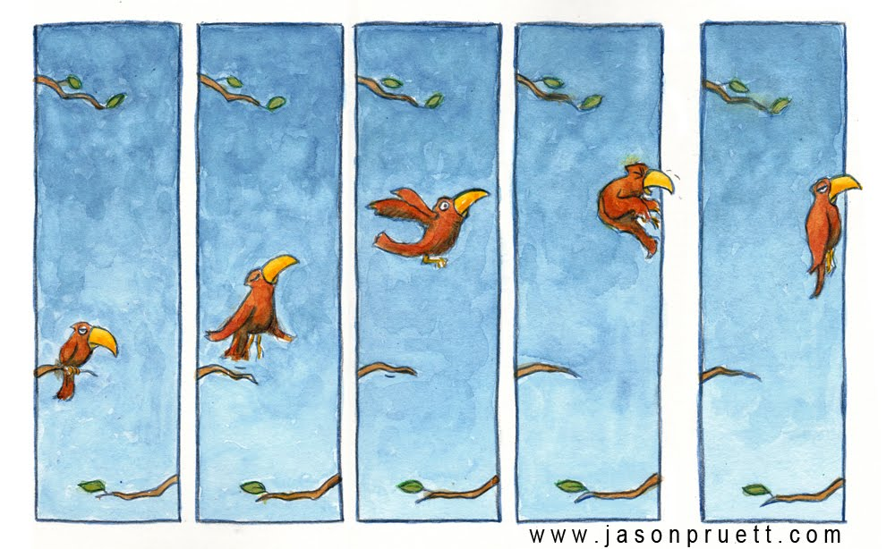
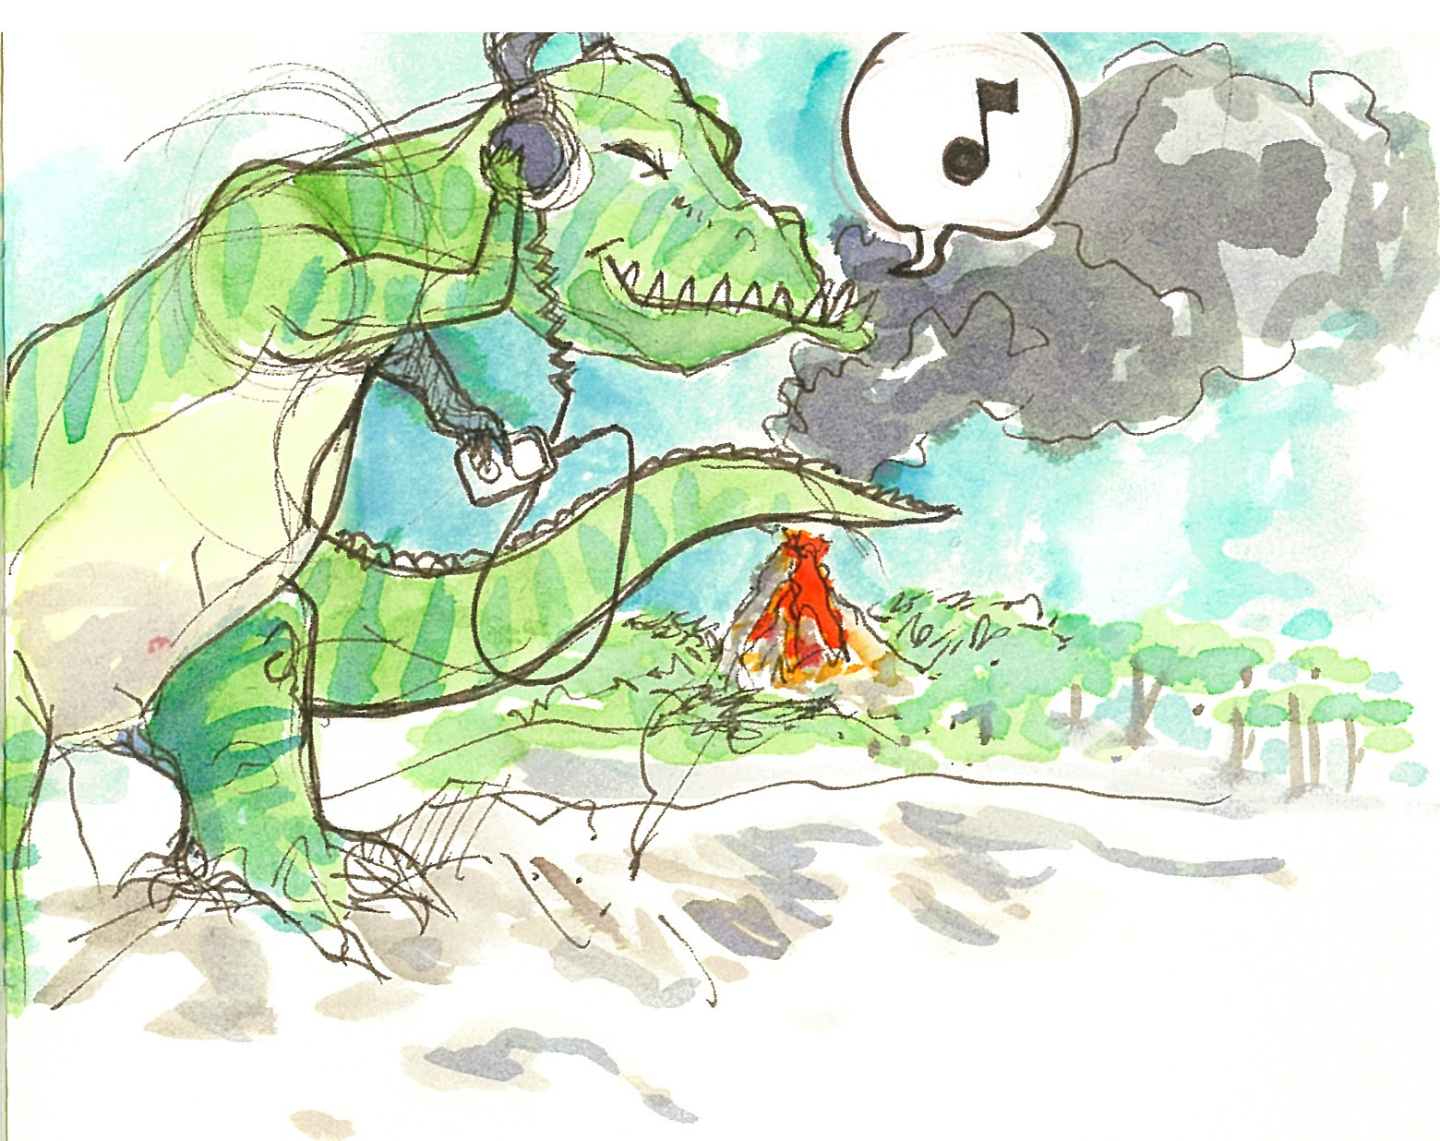
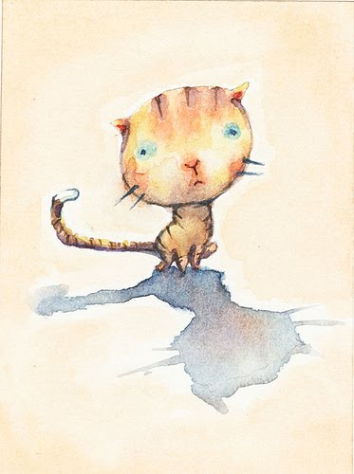
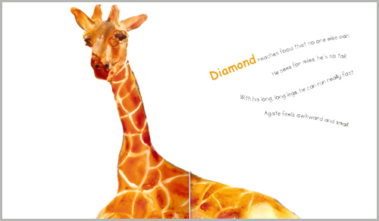
Illustrations in Watercolor

Slide 3
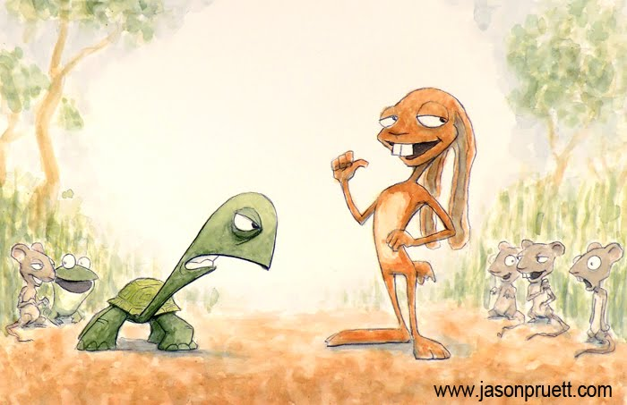
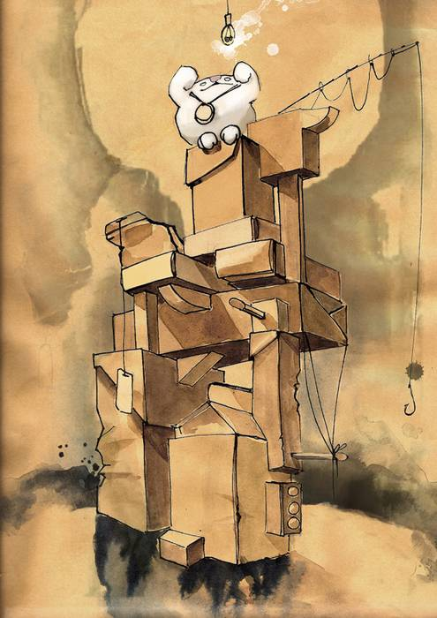
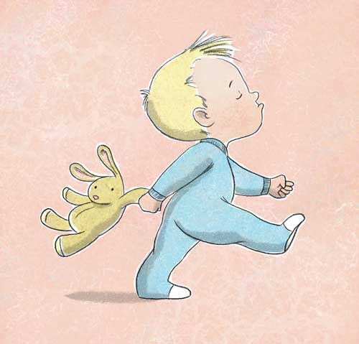
Illustrations in Watercolor

Slide 4
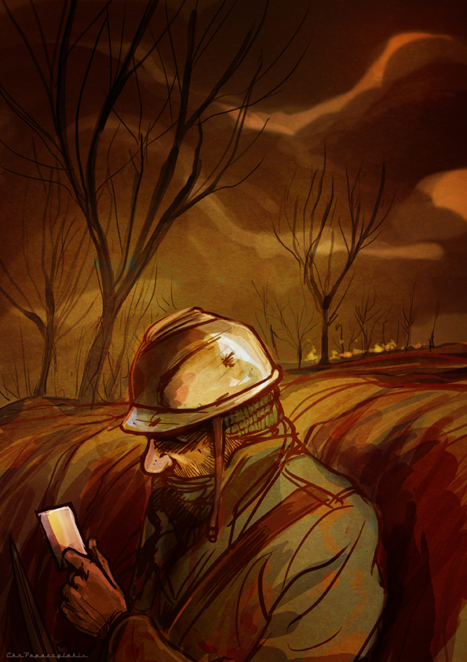
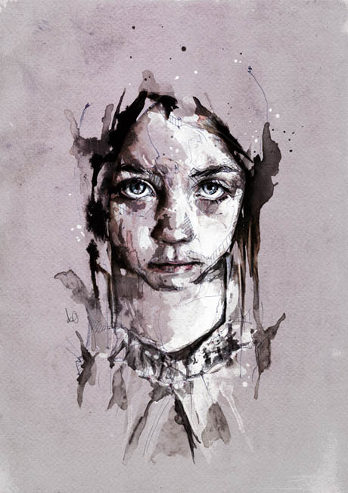
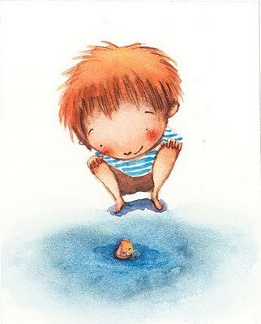
Illustrations in Watercolor

Slide 5
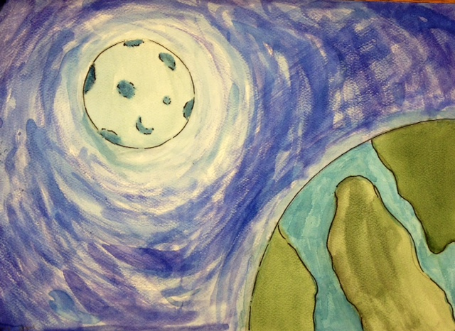
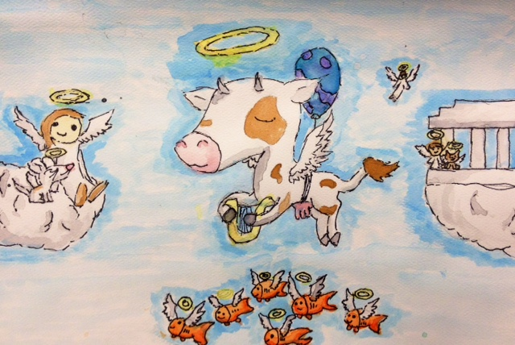
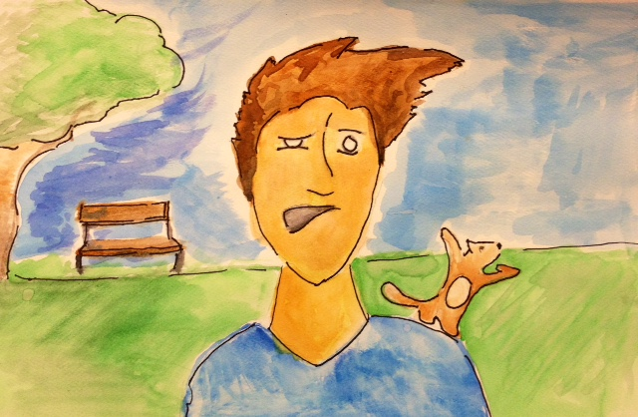
Phrase as an Illustration

Slide 6
Your Assignment
Select a popular phrase and create a literal image of the phrase.
On scratch paper create 2/3 sketches of your ideas. Focus on style, balance, contrast, and emphasis.
Check it off and collect watercolor paper.
Draw BIG BASIC shapes lightly in pencil.
You may tape your watercolor paper to a board. (It may warp)
Start watercolors with light to dark and background to foreground. Recall that you are creating layers to create form.
Proportion, perspective, and values. You need a light source.
You are welcome to lightly outline in ink once your piece is dry. All pieces must have the pencil erased.

